Slide 1


Slide 2
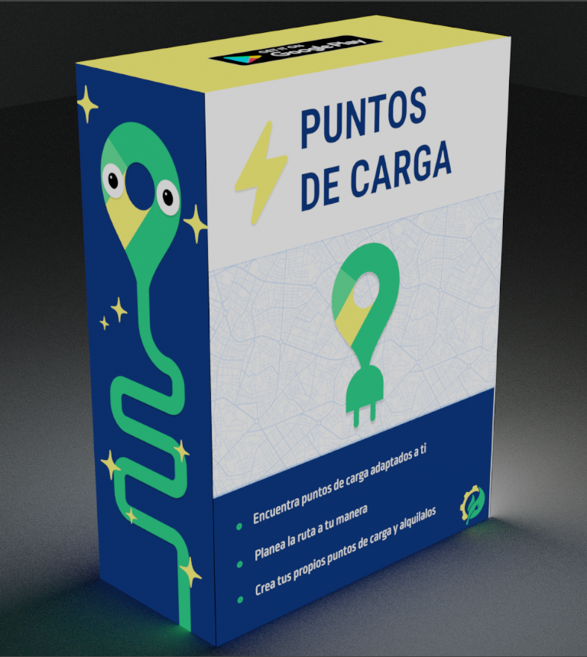
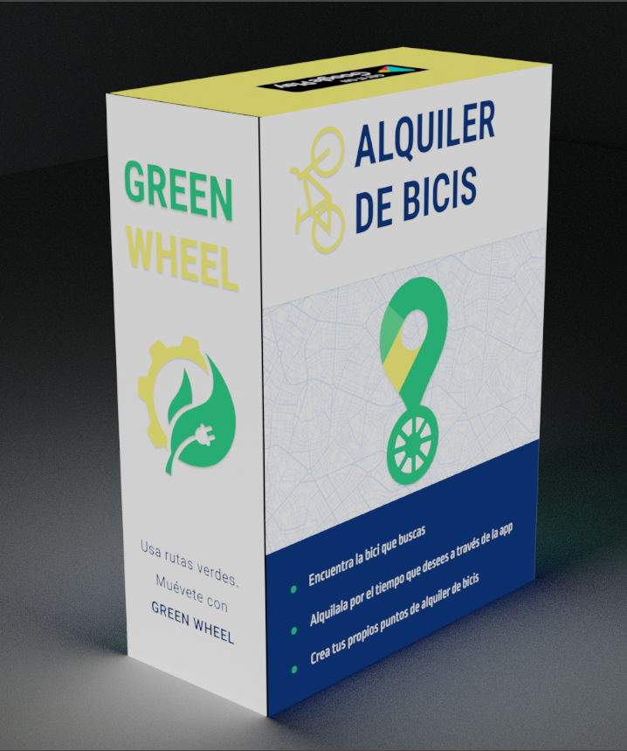
Notes:
https://p3d.in/PIAjV

